Slide 1
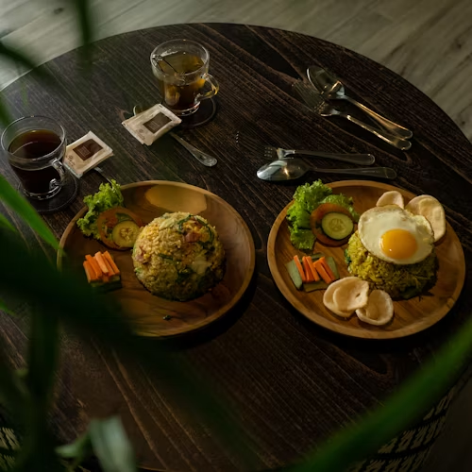

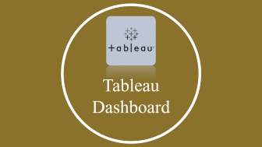




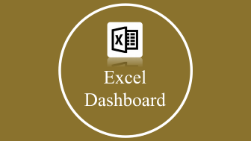


Zomato Analysis Project

Slide 2

Project Team

Slide 3
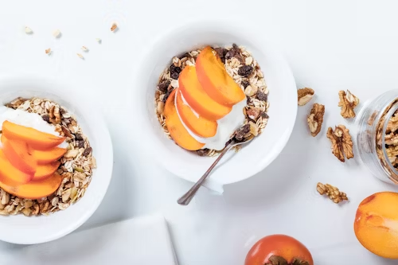


Project Team
Group 6
Sakshi
Nilesh
Rohit
Bhavesh

Slide 4

Introduction

Slide 5
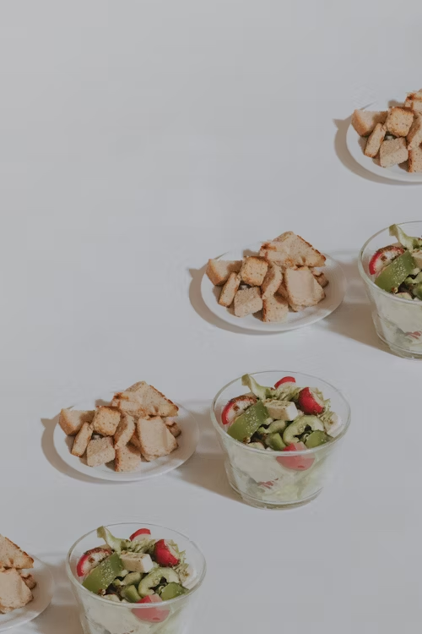
Introduction
Zomato is a leading global food delivery and restaurant discovery platform, revolutionizing the way people dine and order food. With its user-friendly interface and extensive database of restaurants, Zomato connects millions of users with their favorite cuisines. Founded in 2008, Zomato has expanded its presence to over 24 countries, catering to diverse culinary preferences worldwide. Renowned for its comprehensive reviews, ratings, and personalized recommendations, Zomato offers a seamless dining experience for both customers and restaurant partners. As a tech-driven company, Zomato continues to innovate and enhance its services, shaping the future of food delivery and hospitality.

Slide 6

Project Overview

Slide 7


Project Overview
The objective of this project is to conduct an in-depth analysis and visualization of the food service industry, focusing on top-rated restaurants, cuisine popularity, and average cost for two people.
By delving into these aspects, we aim to provide users with a fair understanding of the current landscape of the food service industry.
Furthermore, we seek to identify the various factors influencing different types of restaurants across different locations, popular cuisines, meal types, and most liked dishes.
This analysis will empower users to make informed dining decisions based on factors such as location, restaurant rating, and cuisine preference.

Slide 8

Visualization Software

Slide 9
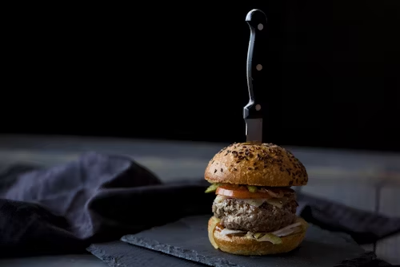




Visualization software
Microsoft Excel
Tableau
Microsoft Power BI
My SQL WORKBENCH

Slide 10

Excel Dashboard

Slide 11

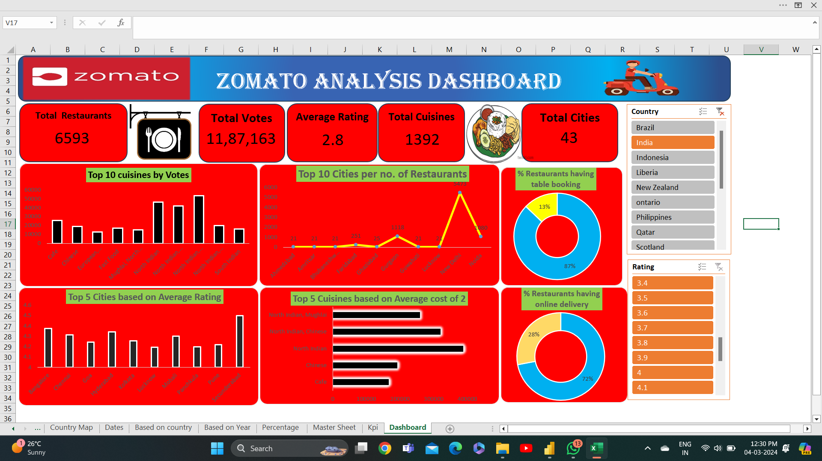
Excel Dashboard

Slide 12

Tableau Dashboard

Slide 13
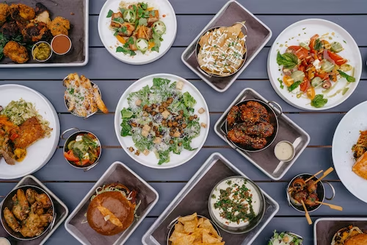
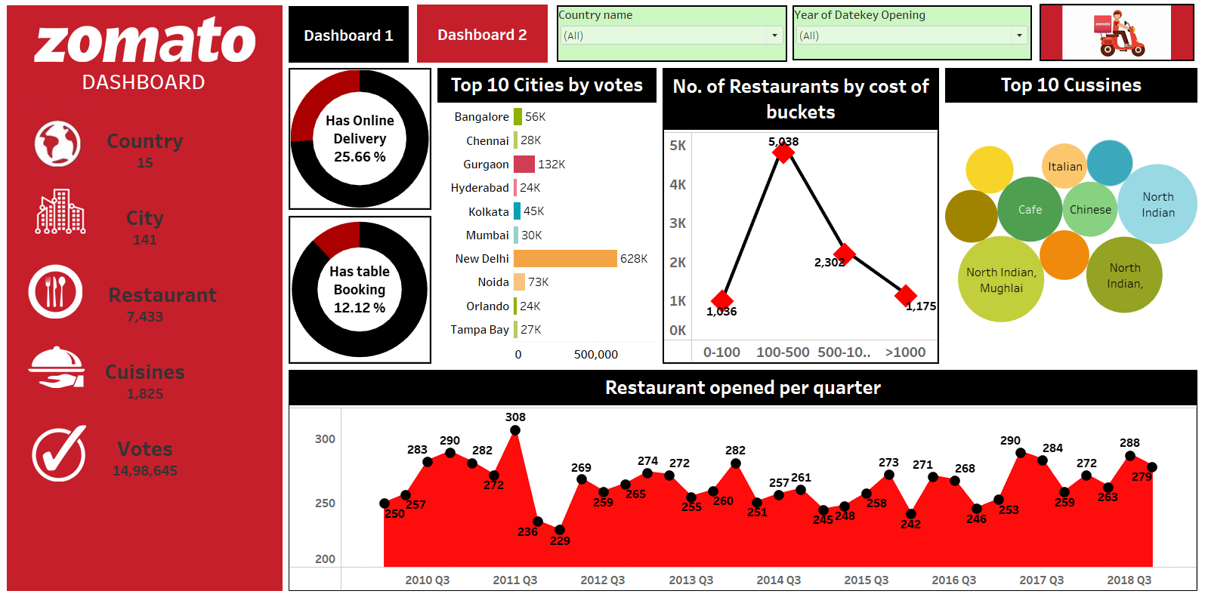
Tableau Dashboard

Slide 14
Microsoft Power BI Dashboard

Slide 15
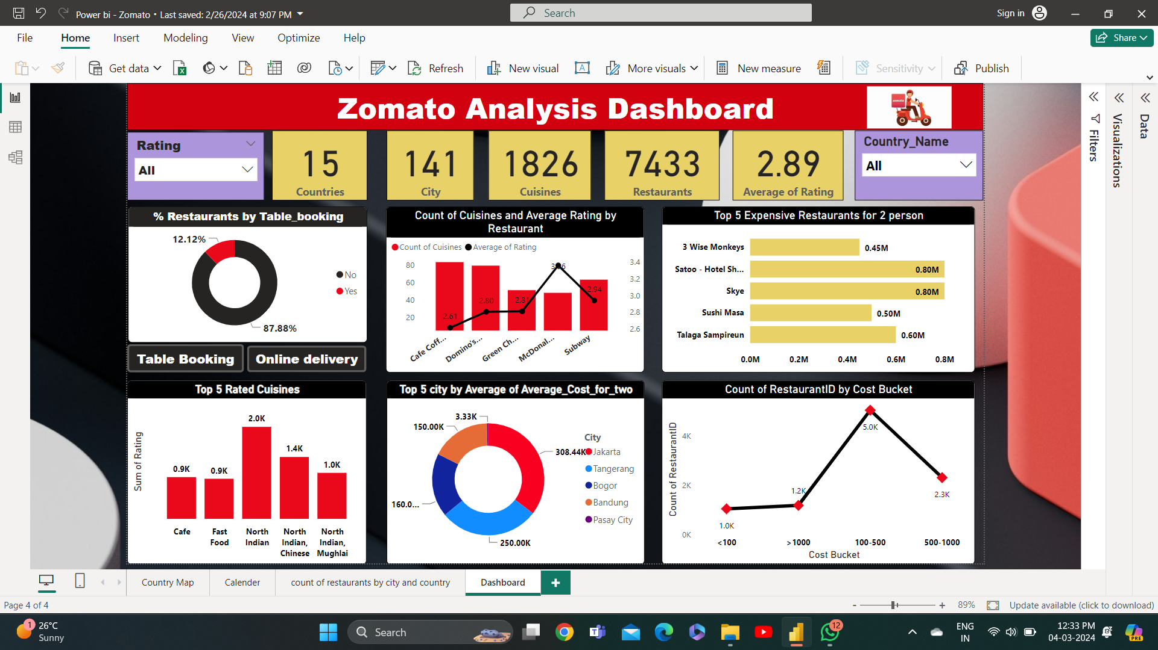
Power BI Dashboard

Slide 16

SQL Queries

Slide 17
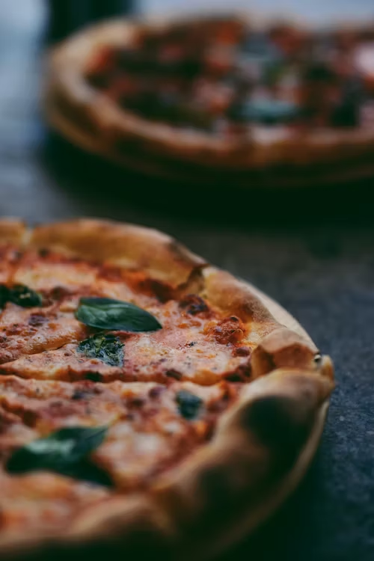
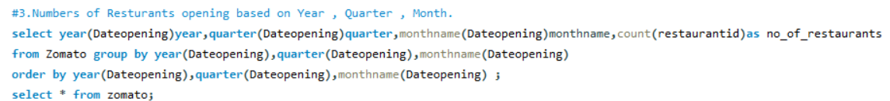
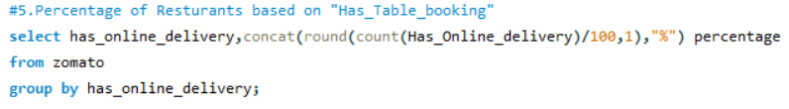
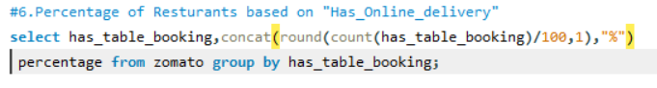
SQL Queries

Slide 18

Business Insights

Slide 19

Business Insights
Menu Optimization: Analyze which items are popular among customers and which ones are not performing well. Consider tweaking your menu based on this feedback to maximize profitability. Highlight your signature dishes and offer attractive deals and combos to attract more customers.
Online Ordering and Delivery: Invest in efficient online ordering and delivery services. Zomato provides a platform for customers to order directly from your restaurant. Ensure that your delivery process is smooth, with timely deliveries and proper packaging to maintain the quality of your food.
Promotions and Offers: Use Zomato's promotional tools to run special offers, discounts, and deals. This could include discounts on certain days or during specific times, loyalty programs, or special menu items available exclusively through Zomato. These promotions can attract new customers and retain existing ones.
Customer Engagement and Feedback: Actively engage with customers on Zomato by responding to reviews, both positive and negative, in a professional and timely manner. This demonstrates your commitment to customer satisfaction and can improve your reputation. Use feedback to make improvements to your service and offerings.
Analytics and Insights: Zomato provides analytics and insights into customer behavior, preferences, and ordering patterns. Utilize this data to understand your customers better, identify trends, and make informed decisions about menu offerings, promotions, and operational improvements.

Slide 20
Conclusion
Zomato records maximum transactions from India that is 90% and then USA and UK which accounts for 5% combined.
Majority of customers preferred not to rate the restaurants.
Also only few restaurants has got 5-star rating.
Further analysis and exploration can be conducted to deleve deeper into specific aspects of the dataset.
Majority of the customer ratings for restaurants are between 3.0 to 3.5 .
Only 1/4th of restaurants in india offers online delivery.
Most of the restaurants provide North Indian cuisine followed by Chinese, fast food and Mughlai cuisines.
Café and Bakery cuisines are in top 10 Providers.
Majority of customers prefer offline service rather than online delivery.

Slide 21

THANK YOU

Slide 22


THANK YOU

